Slide 1
ACT Science

Slide 2
ACT Test Prep
Goals –
  1. Become familiar with many of the concepts that are tested on the official test
  2. Be able to target the item-types that you are best equipped to answer.
    i.e. there are always the same “kinds” of questions on the ACT – know your strengths and your areas for improvement.

Slide 3
What to Expect
http://www.sophia.org/tutorials/what-to-expect-on-the-act-science-test?playlist=act-science-test-preparation

Slide 4
ACT Prep Science Test
35 minutes
40 questions
7 passages

Slide 5
ACT Prep Science Test
The science test is a test of your science reasoning skills.
All of the information you need to answer the questions correctly is provided in the passages

Slide 6
ACT Prep Science Test
The Questions
  The questions cover:
        Biology
        Earth & Space Sciences
        Chemistry
        Physics
All four areas are represented
At least one passage and no more than two passage represent each content area

Slide 7
ACT Prep Science Test
15 questions - data representation
18 questions – research summaries
7 questions – conflicting viewpoints

Slide 8

ACT Prep Science Test
The ACT science test emphasizes scientific reasoning skills rather than recall of scientific content, mathematical skill, or reading ability

Slide 9
ACT Prep Science Test
Unlike the math test you will not be required to remember formulas, definitions, etc.
You are tested on your ability to examine information using text, chart, graphs and tables.

Slide 10
ACT Prep Science
Things to do:
  Read carefully
  Underline
  Make notes in your booklet
  Draw conclusions as you are reading
  Make sure you understand the question

Slide 11
Passage Type:
Data Representation
http://www.sophia.org/tutorials/data-representation-subsection-of-the-act-science?playlist=act-science-test-preparation

Slide 12
Data Representation Characteristics
The passages with only 5 questions
Question types:
· Graphing trends (using a table and graphing it)
· Question using just one table
· Using multiple tables or figures
· Using inferring
· Using extrapolation and interpolation

Slide 13
Data Representation Strategies
Graphs will always be to scale
You can save considerable time by reviewing the graphs and charts visually without necessarily reading the actual numbers
  E.g. in most cases, a taller column will correspond to a greater amount than a shorter column.
  This may be all you need to know!

Slide 14
Graph Reading Strategies
1. Summarize the main point of the graph or chart – read the main title or description.
2. Preview the graph or chart – read the description of the axes and note the units used (as well as their scale!)
3. Quickly summarize and preview – the items will lead back to the actual relevant information.

Slide 15
Tables
Questions about tables may refer to specific rows or columns, and they may ask about the general trends or applications of all the material in a table.
The first step of understanding a table is to understand the nature of the experiment, how it is set up, and how the data is arranged
The second step is to recognize trends (next slide)

Slide 16
Trends
Typical questions ask for predictions of what will happen if particular variables are changed in the experiment or for comparison of the results of two or more trials.
  Be careful not to make unsupported assumptions!

Slide 17
Drawing Conclusions
The third step is to draw conclusions.
Avoid conclusions that are not supported by the data!

Slide 18
Examples of Data Representation on the ACT
Select a conclusion that can be supported by fig 1
Determine what the slope of a given line represents in fig 2
Predict the results given an assumption or a new situation.
Select a statement that is best supported by the data represented in graph 1
Determine the results based on the difference of time or location.
Determine the relationship between two variables.
Determine which conclusion is NOT consistent with the information given in graph 2
Select an explanation for a given outcome
Identify the LEAST significant assumption made when determining a particular outcome.

Slide 19
Passage Practice
The kinetic energy of an object with mass m (measured in grams) after a fall from height h (measured in centimeters) was recorded for different heights. A graph was made representing the kinetic energy vs. height.

Slide 20
Passage I, Question 1.
If the kinetic energy is given in units of g * cm² / s² , what units must the slope have?
  g * cm/s
  g * cm/s²
  g * cm/g
  s² / (g * cm)

Slide 21
Passage I, Question 2.
2. It is discovered that if we redo the experiment with an object with twice the mass, the kinetic energy obtained for every height is doubled. The slope of the new set of experiments can be obtained by doing what to the old slope?
Multiplying by 2
Dividing by 2
Squaring
Taking the square root.

Slide 22
Passage I, Question 3.
What would be the kinetic energy in g * cm² / s² of an object of mass m if t were dropped from a height of 4.5 cm?
4.5
9.0
45
90

Slide 23
Passage I, Question 1.
If the kinetic energy is given in units of g * cm² / s² , what units must the slope have?
  g * cm/s
  g * cm/s²
  g * cm/g
  s² / (g * cm)
What is the formula for slope? Rise over Run (y/x). Determine the units for rise (y axis) and divide them by the run (x axis).

Slide 24
Passage I, Question 2.
2. It is discovered that if we redo the experiment with an object with twice the mass, the kinetic energy obtained for every height is doubled. The slope of the new set of experiments can be obtained by doing what to the old slope?
Multiplying by 2
Dividing by 2
Squaring
Taking the square root.
Think about the phrases:
- “kinetic energy is doubled” = y axis
Height is not mentioned; x axis does not change
slope = rise/run,
or y/x

Slide 25
Passage I, Question 3.
What would be the kinetic energy in g * cm² / s² of an object of mass m if t were dropped from a height of 4.5 cm?
4.5
9.0
45
90
At 1 cm, our KE was 10. At 2 cm, our KE was 20. Seems like a 1:10 correlation, and that our x is directly proportional to our y (not exponential or inversely related)
So, if at 1 cm we have a y value of 10, and at 2 cm, we have a y value of 20, our 10x = y.
If x =4.5, then y = 45.
So, it should be C.
THINK: Why might they choose 90 as the other alternative? Reviewing the other answers may reveal the pitfalls.

Slide 27
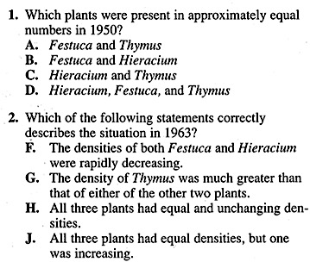
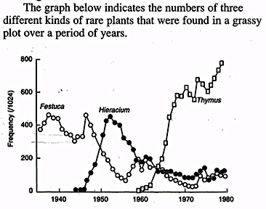
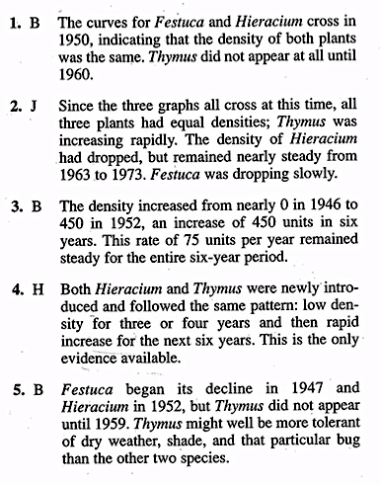
Sample
Answer the following questions in your notebook

Slide 28
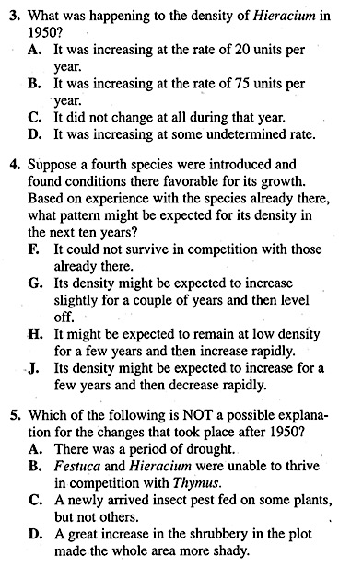
Sample
Answer the following questions in your notebook

Slide 29
First Five: Answers
Monday/Tuesday- Data Representation
Correct your answers on your ACT Tracking handout
  C
  J
  B
  J
  A
Add up the number you got right in write it in the bottom of the column

Slide 30
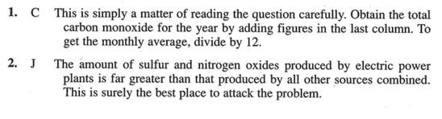
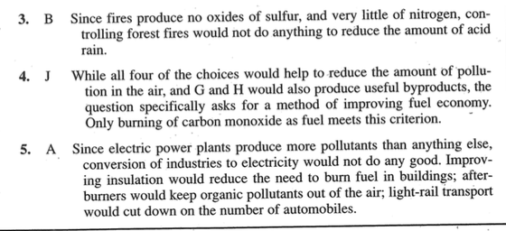
First Five: Answers
Monday/Tuesday- Data Representation
Correct your answers on your ACT Tracking handout
  C
  J
  B
  J
  A
Add up the number you got right in write it in the bottom of the column

Slide 31
First Five: Answers
Wednesday/Thursday- Data Representation
Correct your answers on your ACT Tracking handout
  C
  J
  B
  F
  A
Add up the number you got right in write it in the bottom of the column

Slide 32
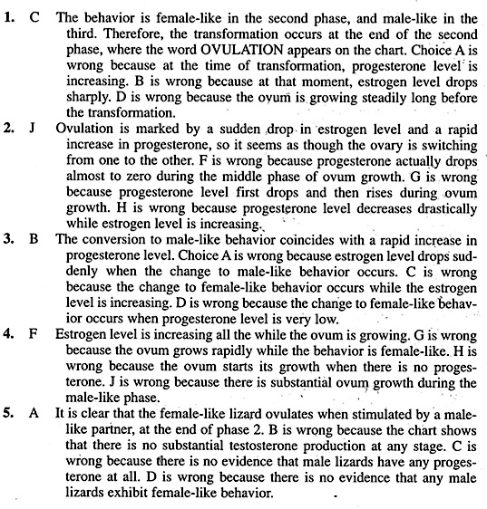
First Five: Answers
Wednesday/Thursday- Data Representation
Correct your answers on your ACT Tracking handout
  C
  J
  B
  F
  A
Add up the number you got right in write it in the bottom of the column

Slide 33
First Five: Answers
Friday- Data Representation
Correct your answers on your ACT Tracking handout
  C
  J
  A
  G
  D
Add up the number you got right in write it in the bottom of the column

Slide 34
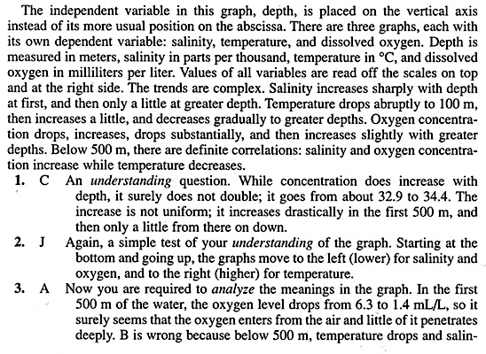
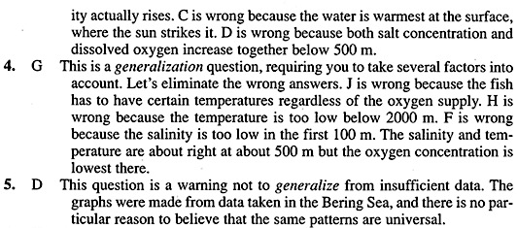
First Five: Answers
Friday- Data Representation
Correct your answers on your ACT Tracking handout
  C
  J
  A
  G
  D
Add up the number you got right in write it in the bottom of the column

Slide 35
First Five: Answers
Friday- Data Representation
Correct your answers on your ACT Tracking handout
  C
  J
  A
  G
  D
Add up the number you got right in write it in the bottom of the column

