Slide 1
Heart Disease Packet

Slide 2
Learning objectives
To understand the causes of coronary heart disease and other cardiovascular diseases
To know the risk factors for heart disease
The understand the role cholesterol plays in the development of heart disease
To analyze data on factors relating to heart diseas

Slide 3
Contents of Presentation
Slide Numbers | Contents
4-22 | Part 1: Coronary Heart Disease
23-41 | Part 2: Other Cardiovascular Diseases
42-49 | Part 3: Data and Heart Disease
50-70 | Miscellaneous

Slide 4
Coronary heart disease
PART 1

Slide 5
Coronary heart disease
Part 1
Coronary heart disease (CHD) is caused by a narrowing of the blood vessels to the heart. This reduces the flow of blood to the heart.
If one of the blood vessels becomes completely blocked, the blood supply to part of the heart stops and is damaged. This is called a heart attack.
If the blood supply to a large part of the heart is stopped it may cause death.

Slide 6
Build up of fat
Part 1
The deposit on blood vessels walls, which reduce the flow of blood, takes years to build up. It is made up of substances, including cholesterol and very small blood clots.
High levels of cholesterol in the blood increase the build up of the deposit.

Slide 7
Rates of CHD
Part 1
Heart disease is the most common cause of death in the United States. CHD is the most common type of heart disease. It is a major cause of premature death (death before the age of 65 years).
In 2006 CHD accounted for 30% of premature deaths in men and 22% of premature deaths in women.
CHD is more common in men than in women.
http://www.cdc.gov/heartdisease/facts.htm

Slide 8
Rates of CHD
Part 1
CHD death rates have been falling fast in those aged over 55 years and older.
Between 1997 and 2006, there was a fall of 46% in the CHD death rate for men aged 55 to 64 years in the UK, and a similar fall in the USA.
In women there was a 53% fall in those aged 55 to 64 years.

Slide 9
Risk of CHD
Part 1
The chance of suffering from CHD is affected by many factors. These are called risk factors.
Factors that increase the risk of CHD include being:
• male;
• older;
• a cigarette smoker;
• overweight;
• inactive;
• stressed.

Slide 10
Risk of CHD
Part 1
Other risk factors for CHD include having:
• a family history of CHD;
• high blood cholesterol level;
• high blood pressure;
• high intake of saturated fats;
• diabetes.
Some factors cannot be changed, such as
family history. Other factors can be changed, for
example diet or other aspect of lifestyle which are
called modifiable risk factors.

Slide 11
Blood cholesterol levels
Part 1
Cholesterol is a type of fat that is essential for the body
(not in the diet) in small amounts. It is produced in the
liver and some is also obtained from the diet.
Cholesterol is carried around the body in the blood.
High levels of cholesterol in blood increase the risk of
CHD.
The level of cholesterol in the blood depends partly on
genetic factors, but diet is also important.

Slide 12
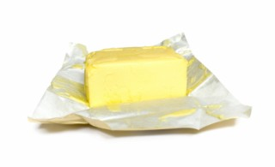
Cholesterol and the diet
Part 1
The level of blood cholesterol is affected by the amount and type of fat in the diet.
High intakes of saturated fatty acids, and of total fat, can increase the amount of cholesterol in the blood, and therefore increase the risk of CHD.
Most people are consuming too much saturated fat and need to switch to foods containing unsaturated fat or remove visible fat.

Slide 13
Reducing cholesterol in the diet
Part 1
Before cholesterol can be deposited on blood vessel walls, it is changed by a chemical reaction called oxidation. Substances called antioxidants can help to prevent this reaction happening and so reduce the amount of deposit formed in the blood vessels.
Examples of antioxidants include vitamins A, C, and E. These are found in fruit and vegetables.

Slide 14
Blood pressure
Part 1
High blood pressure increases the risk of CHD. Blood pressure tends to be raised in people who:
• are very overweight;
• drink a lot of alcohol;
• take little exercise;
• smoke cigarettes;
• eat a lot of salt.
Considering which of these factors are relevant, and altering them is necessary, can help to reduce blood pressure.

Slide 15
Maintaining a healthy weight
Part 1
Being very overweight (obese) increases the risk of CHD.
Eating a balanced diet and being physically activity is important in maintaining a healthy body weight.
This will also reduce the risk of high blood pressure, which is a risk factor for CHD.

Slide 16
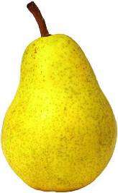
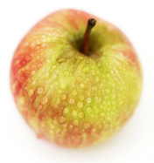
Distribution of fat
Part 1
The distribution of fat in the body also affects risk.
People who have a high proportion of fat around the central part of the body (‘apple shaped’) have a greater risk of CHD than those who have most of their fat around the hips and thighs (‘pear shaped’).
Men tend to be more ‘apple shaped’ whereas women tend to be more ‘pear shaped’.

Slide 17
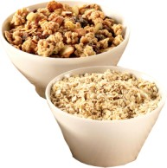
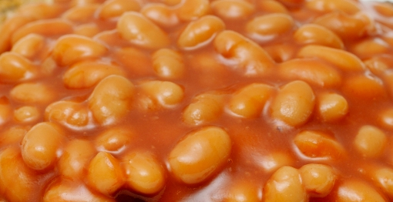
Soluble fiber
Part 1
Where is it found?
Soluble fiber is a type of dietary fiber (NSP) which is found in foods such as oats, vegetables and beans.
How is it good for heart health?
It has been shown to reduce blood cholesterol levels and therefore may reduce the risk of CHD.

Slide 18
Omega 3 fatty acids
Part 1
Where is it found?
Oily fish such as salmon, sardines and mackerel.
How is it good for heart health?
Fatty acid found particularly in oily fish reduces clotting. Increased consumption of these foods, therefore, may reduce the risk of CHD.

Slide 19
Fatty acids
Part 1
There are many different fatty acids. Different types of fatty acids behave differently in the body.
Fatty acids can be divided into two groups:
1) Saturated – these have the hydrogen atoms they can hold and all are single chemical bonds, e.g. stearic acid.
Single bond

Slide 20
Fatty acids
Part 1
2) Unsaturated – these have some hydrogen atoms missing and contain double bonds.
• Monounsaturated – this is where there is one double bond, e.g. oleic acid.
• Polyunsaturated – this is where there are more than one double bond in the compound, e.g. linoleic acid.
Double bond

Slide 21
Fatty acids
Part 1
Most people in the United Kingdom are eating too much saturated fat.
Unsaturated fats are normally liquid at room temperature, are usually of a vegetable origin, and are commonly known as oils.
Olive oil is an example of an oil predominately containing monounsaturated fat.
Sunflower oil is an example of a polyunsaturated fat.

Slide 22
Cutting back fat tips
Part 1
Helpful guidelines on how to reduce fat (in particular saturated fat) in the diet include:
• Cut down – try to limit the amount of high fat foods consumed.
• Look for low fat – read food labels and make the choice to purchase food lower in fat.
• Change your cooking – trimming fat from meat before cooking it is an easy way to create a dish lower in fat.
• Swaps – switching high fat food with a lower fat alternative foods, e.g. ice cream with low fat Greek yogurt.

Slide 23
Other Cardiovascular Diseases
PART 2
Source: https://www.tes.co.uk/teaching-resource/Heart-disease--AQA-As-Biology-6126048

Slide 24
CVD: Atherosclerosis
Part 2
This is caused by a build-up of cholesterol fibres, dead muscle cells and platelets on the inside of the coronary artery, called an atheroma which reduces the flow of blood and therefore oxygen to the tissues.
It is more likely to develop upon damage to the artery wall by high blood pressure, carbon monoxide or nicotine.

Slide 25
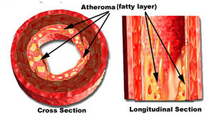
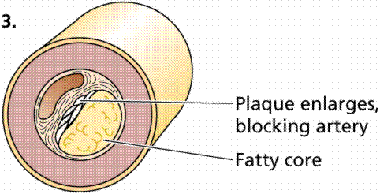
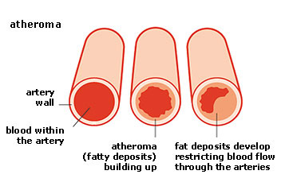
CVD: Atherosclerosis
Part 2
The atheroma can collect minerals and become hardened to form a rough plaque. The plaques bulge into the lumen of the artery causing it to narrow so that blood flow is reduced.

Slide 26
CVD
Part 2
The atheroma can collect minerals and become hardened to form a rough plaque. The plaques bulge into the lumen of the artery causing it to narrow so that blood flow is reduced.

Slide 27
Thrombosis
Part 2
If the atheroma breaks through the endothelium (cells lining the inside of the artery) it forms a rough surface that interrupts the smooth flow of blood. This may result in formation of a blood clot or thrombus.
This is known as thrombosis. The thrombus may block the blood vessel reducing or preventing blood supply to the tissues (cardiac muscle).

Slide 28
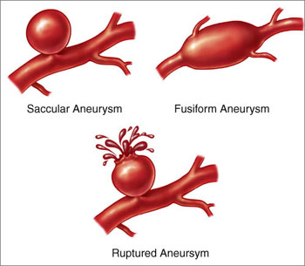
CVD: Aneurysm
Part 2
The plaque weakens the wall of the artery. The weakened points swell to form a balloon-like structure called an aneurysm.
If the wall is particularly weak it may burst causing a haemorrhage or blood loss and possibly death.

Slide 29
CVD: Myocardial Infraction
Part 2
Any cardiac cells that are supplied by this blood vessel will be starved of oxygen and glucose and therefore cannot respire.
These cells will die – this is called a myocardial infarction or heart attack.
The severity of the heart attack depends on how far along the coronary artery the thrombosis is. If the blockage is close to the junction of the coronary artery and the aorta the heart will stop beating – WHY?

Slide 30
Part 2

Slide 31
Stroke
Part 2
These occur if an artery in the brain bursts and blood leaks into the brain tissue or when an artery supplying the brain becomes blocked.
The brain tissue becomes starved of oxygen and dies. Strokes can be fatal or very mild and may affect speech, memory and control of the body.

Slide 32
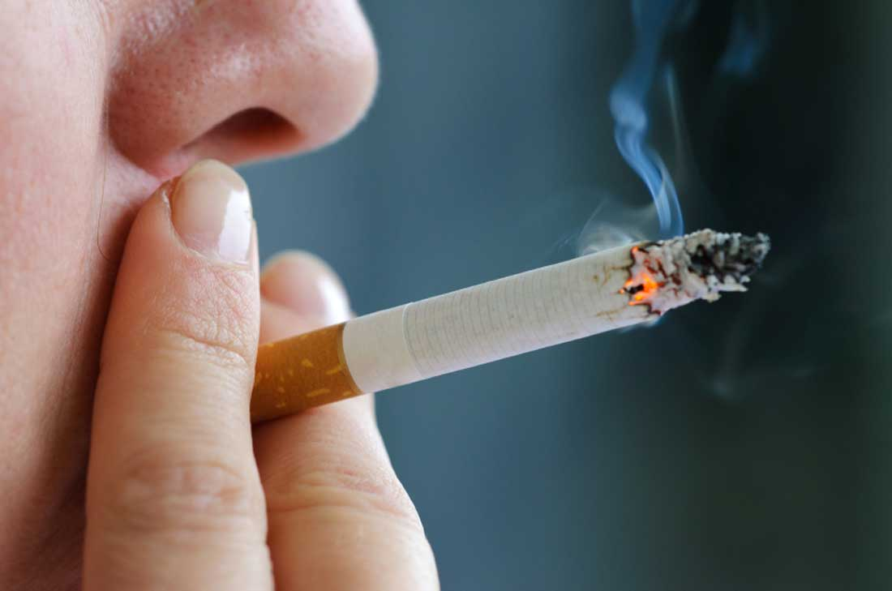
Risk Factors for CVD
Part 2
Smoking increases the concentration of blood cholesterol, which is a risk factor, so smokers increase the risk of having heart disease or a stroke.

Slide 33
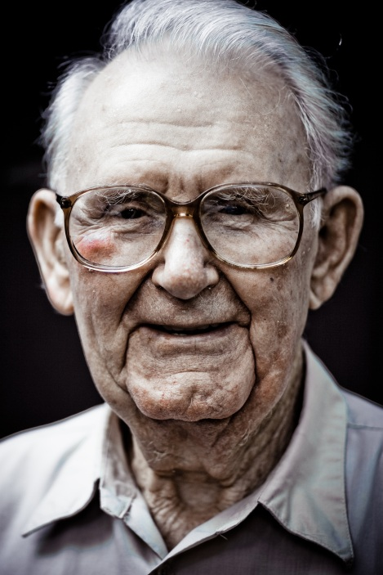
Risk Factors for CVD
Part 2
The risks of developing the disease increases with age and men are more at risk than women.

Slide 34
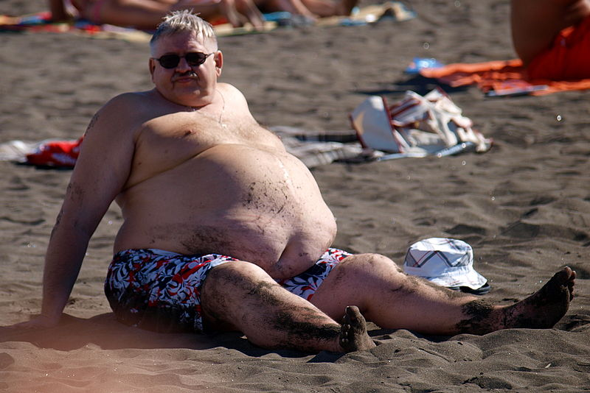
Risk Factors for CVD
Part 2
Being overweight increases the risk as does eating a diet high in saturated fat and salt. Diets with more antioxidants (vitamins) and soluble fibre decrease the risk as does taking regular exercise.

Slide 35
Risk Factors for CVD
Part 2
Having diabetes raises the risks and high alcohol intake is another contributory factor.

Slide 36
Cholesterol
Part 2
Cholesterol in the blood comes from the diet and from the liver, where it is synthesized. Cholesterol is carried in large complexes with proteins, called lipoproteins.
High-density lipoproteins (HDLs) remove cholesterol from tissues and transport it to the liver for excretion, so decrease the risk of atheromas.
They help protect arteries from heart disease. Low-density lipoproteins deliver cholesterol to tissues, including artery walls so increase the risk of atheromas and heart disease.

Slide 37
Cholesterol - extra
Part 2
Cholesterol is a fatty substance (a lipid) that is an important part of the outer lining (membrane) of cells in the body of animals. Cholesterol is also found in the blood circulation of humans. The cholesterol in a person's blood originates from two major sources; dietary intake and liver production. Dietary cholesterol comes mainly from meat, poultry, fish, and dairy products. Organ meats, such as liver, are especially high in cholesterol content, while foods of plant origin contain no cholesterol. After a meal, cholesterol is absorbed by the intestines into the blood circulation and is then packaged inside a protein coat. This cholesterol-protein coat complex is called a chylomicron.

Slide 38
High Blood Pressure
Part 2
Increases the risk of an aneurysm and stimulates thickening of artery walls, increasing the risk of thrombosis. Prolonged stress, diet and lack of exercise can all increase blood pressure. High blood pressure increases the risk of heart disease because:
Higher pressure in arteries means the heart has to work harder to pump blood into them – therefore increases risk of failure.
To resist higher pressure the walls of the arteries thicken, which restricts the blood flow.

Slide 39
Genetics
Part 2
Both blood pressure and fat metabolism are affected by genes, so genes undoubtedly affect the chance of a coronary thrombosis.
This doesn’t mean that, for some people, a heart attack is inevitable; it just means some people have to be even more careful about their lifestyle risk factors.

Slide 40
Diet
Part 2
High levels of saturated fat increase the amount of low-density lipoproteins and hence increases the amount of cholesterol carried in the blood.
This increases the risk of atherosclerosis. High levels of salt increase blood pressure and so increase the risk of aneurysm.

Slide 41
Smoking
Part 2
Smokers are between two and six times more likely to suffer from coronary heart disease than non-smokers. There are two main constituents of tobacco smoke that increase the likelihood of heart disease:
Carbon monoxide – combines irreversibly with haemoglobin to form carboxyhaemoglobin, reducing the oxygen-carrying capacity of the blood. The heart must work harder to supply the tissues with oxygen therefore increasing blood pressure and increasing the risk of heart disease.
In severe cases this can lead to chest pain (angina) and myocardial infarction.
Nicotine – stimulates production of adrenaline which increases the heart rate and raises blood pressure. Nicotine also makes the red blood cells more ‘sticky’ so increasing the risk of thrombosis and hence strokes and myocardial infarction.

Slide 42
Data and Heart Disease
PART 3

Slide 43
Data and Heart Disease: Directions
Part 3
Use the following data tables and graphs to answer the questions on your worksheet.

Slide 44
Example 1: Figure 1-14
Part 3

Slide 45
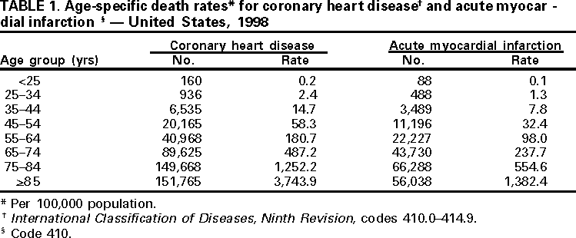
Example 2: Table 1
Part 3

Slide 46
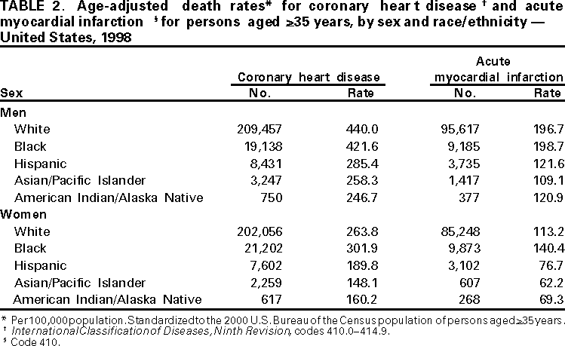
Example 3: Table 2
Part 3

Slide 47
Example 4: Table 13-1
Part 3

Slide 48
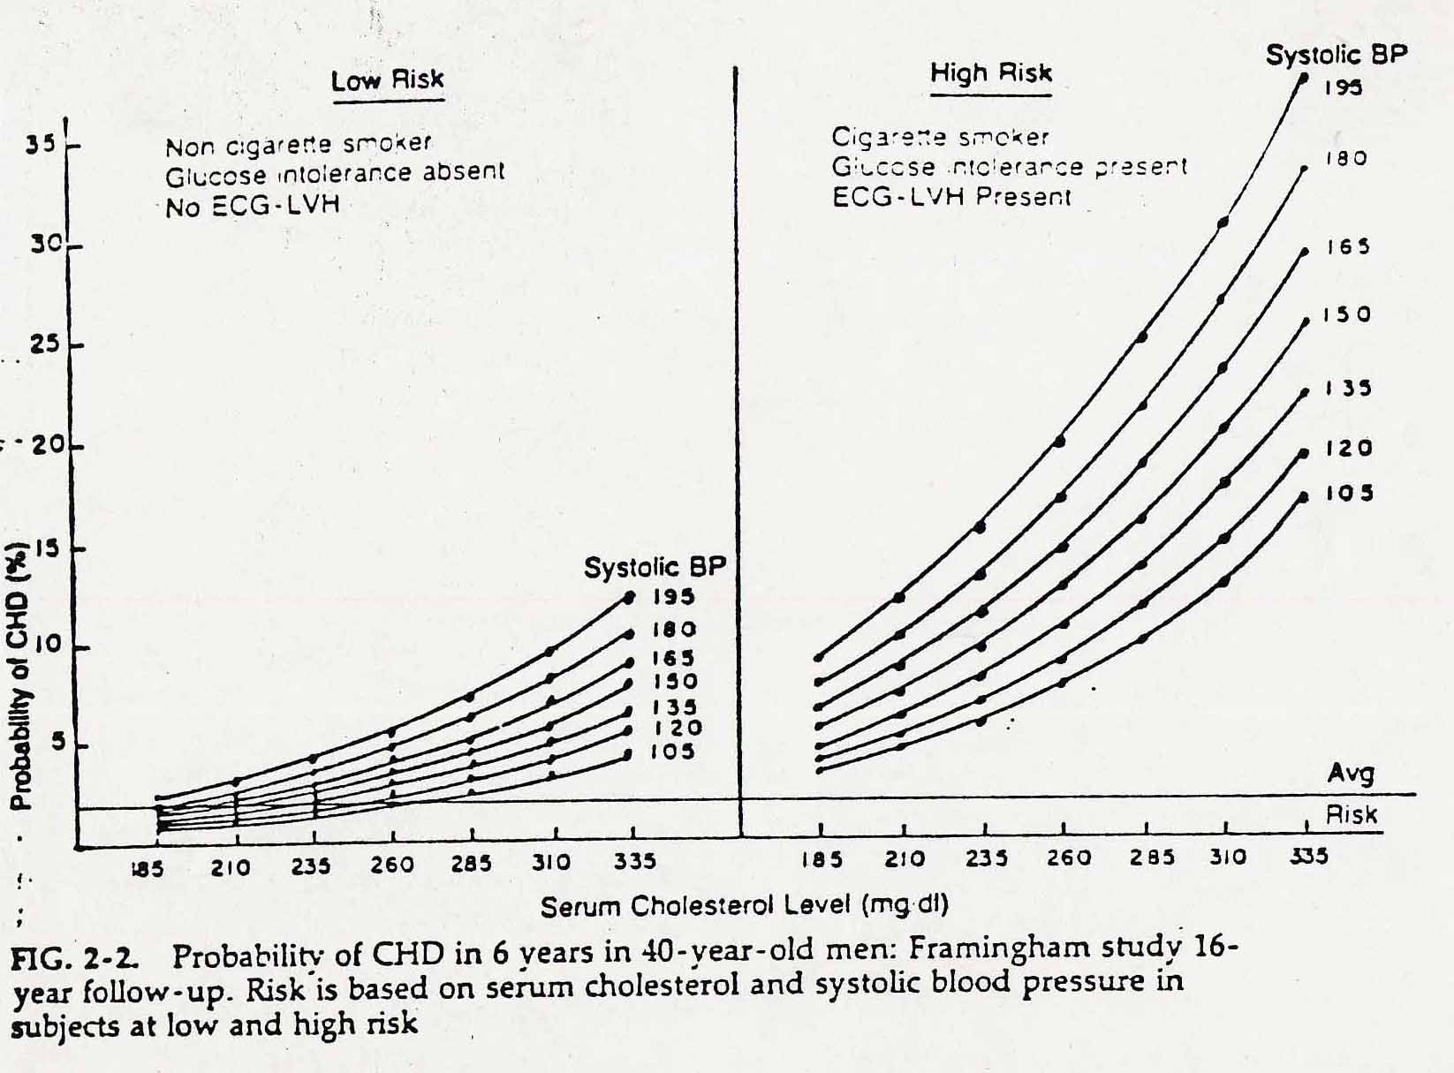
Example 5: Fig. 2-2
Part 3

Slide 49
Example 6: Figure 1-8
Part 3

Slide 50
Additional Info (optional slides)
https://www.tes.co.uk/teaching-resource/AQA-3-1-5-AS-Biology--Heart-and-Heart-Diseases-6380648

Slide 51
Heart disease – why worry?
Heart disease kills more people in the UK than any other disease.
Almost half of heart disease deaths are from coronary heart disease (CHD).
CHD affects the pair of blood vessels – the coronary arteries, which supply the heart muscle with the glucose and oxygen that it requires for respiration.

Slide 52
Atheroma
Atheroma is the name for a fatty deposit which forms within the wall of an artery.

Slide 53
Atheroma
It begins as fatty streaks that are accumulations of white blood cells that have taken up low-density lipoproteins (LDLs).
LDLs are the “bad” form of cholesterol.

Slide 54
Atheroma
Fatty streak laid down by LDL-laden white blood cells.
Streaks start to enlarge to form an atheromatous plaque (these most commonly occur in larger arteries).
These plaques bulge into the lumen of arteries and restrict the flow of blood.

Slide 55
Thrombosis
As the blood flow is restricted, blood pressure increases.
This causes some damage to the lining (endothelium) of the artery.
Platelets start to aggregate and lay down a blood clot.
This is now called a thrombus.

Slide 56
Thrombosis
Sometimes a thrombus may become dislodged and move around the body.
This mobile thrombus can settled elsewhere and block other arteries and veins.
This is particularly problematic if the thrombus moves to the lungs.

Slide 57
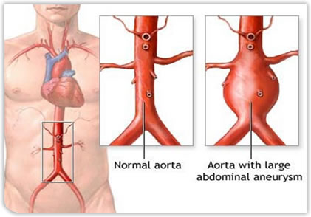
Aneurysm
Atheromas that lead to the formation of a thrombus also weaken the artery walls.
These weakened points swell to form a balloon-like blood-filled structure called an aneurysm.
Aneurysms frequently burst, leading to haemorrhage.
This then leads to a loss of blood in that region of the body.
A brain aneurysm is known as a cerebrovascular aneurysm (CVA), or stroke.

Slide 58
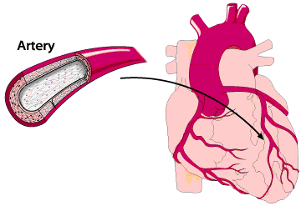
Myocardial infarction
Also known as a heart attack.
The term literally means a reduced supply of oxygen to the muscle of the heart.
MI is a symptom of CHD.
MI results from a blockage in one of the coronary arteries.

Slide 59
Myocardial infarction
If the blockage is close to the junction of the coronary artery and the aorta, then the heart will stop beating because the blood supply is completely cut off.

Slide 60
Write definitions for the following terms
Atheroma
Thrombosis
Aneurysm
Myocardial infarction

Slide 61
What are the risk factors for CHD?
Smoking
High blood pressure
Blood cholesterol
Diet

Slide 62
How do you think these factors increase the risk?
Smoking
High blood pressure
Blood cholesterol
Diet
Notes:
Discuss with the students. Was prev. Covered in the lifestyle section so they should have some ideas.

Slide 63
Smoking
There are two main constituents of tobacco smoke which increase likelihood of heart disease:
Carbon monoxide
Nicotine

Slide 64
Carbon monoxide
Combines irreversibly with Hb of RBCs.
This means that the oxygen carrying capacity of the blood is reduced.
This will remain throughout the whole lifespan of the RBC (~120 days).
This could lead to insufficient supply of oxygen to the heart during exercise.

Slide 65
Nicotine
Stimulates the production of adrenaline which increases heart rate and blood pressure.
This increases the risk of CHD or CVA.
Nicotine also makes RBCs more “sticky” – leading to a higher risk of thrombosis.

Slide 66
High Blood Pressure
As there is already pressure in the arteries, the heart must work harder to pump blood into them and is therefore more prone to failure.
Higher blood pressure within the arteries means that they are more likely to develop an aneurysm and burst.
To resist the higher blood pressure within them, the walls of the arteries may become hardened and thickened – leading to restricted flow of blood.

Slide 67
Blood cholesterol
Cholesterol is an essential component of membranes. As such, it is an essential biochemical which must be transported in the blood. It is carried in the plasma in tiny spheres of lipoprotein (lipid and protein). There are two main types:
High-density liproprotein (HDLs)
Low-density liprorotein (LDLs)

Slide 68
HDLs
These remove cholesterol from tissues and transport it to the liver for excretion. They help protect arteries against disease.

Slide 69
LDLs
These transport cholesterol from the liver to the tissues, including the artery walls, which they infiltrate, leading to the development of atheroma and hence heart disease.

Slide 70
Diet
There are a number of aspects of diet which increase the risk of heart disease, both directly and indirectly:
High levels of salt raise blood pressure.
High levels of fat increase LDL level and hence blood cholesterol concentration.

