Slide 1
Directions for Classwork: May 13
Turn-in the “HW- Reproductive System Worksheet” along with any other work you owe me to the temporary class turn-in tray
Complete the packet called- “CLASSWORK-Fertilization & Pregnancy Worksheet”
Use these slides, the class set reading “Pregnancy- The Basics,” the video links in these slides, and any other Internet/class notes resources to help
Begin working on the HW-Reproduction Problems
REMINDER: Deadline to submit late work AND Diseases Quiz Corrections for April 13-May 13 is TOMORROW (Thursday), May 14 at 5pm

Slide 2
Classwork Objectives: Pregnancy Worksheet
What you will need to know:
How does a fertilized egg develop into a baby?
How is a growing fetus fed?
How is the growing fetus protected?
•

Slide 3
Part 1: Fertilization

Slide 4
Fertilization Links
Video 1: https://www.youtube.com/watch?v=_5OvgQW6FG4
Video 2 (Animation): https://www.youtube.com/watch?v=btp4jCYZ5K4
Optional Reading: https://www.ck12.org/life-science/Fertilization-in-Life-Science/lesson/Fertilization-Basic/?referrer=concept_details
Video 3 (Sperm Meets Egg): https://www.youtube.com/watch?v=vFfqLs94iHc
Video 4: https://www.youtube.com/watch?v=3vUeM4gydAU
These optional links will give you a good overview of the topic

Slide 5
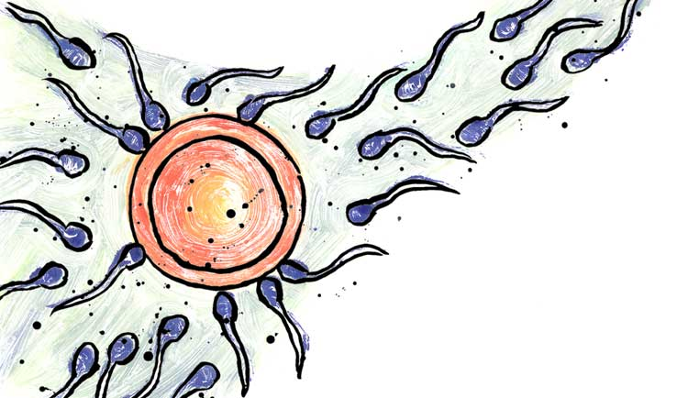
What is fertilization?
When the sperm and the egg FUSE together.

Slide 6
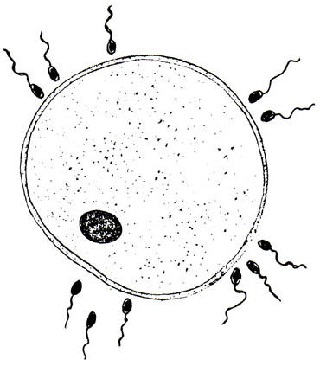
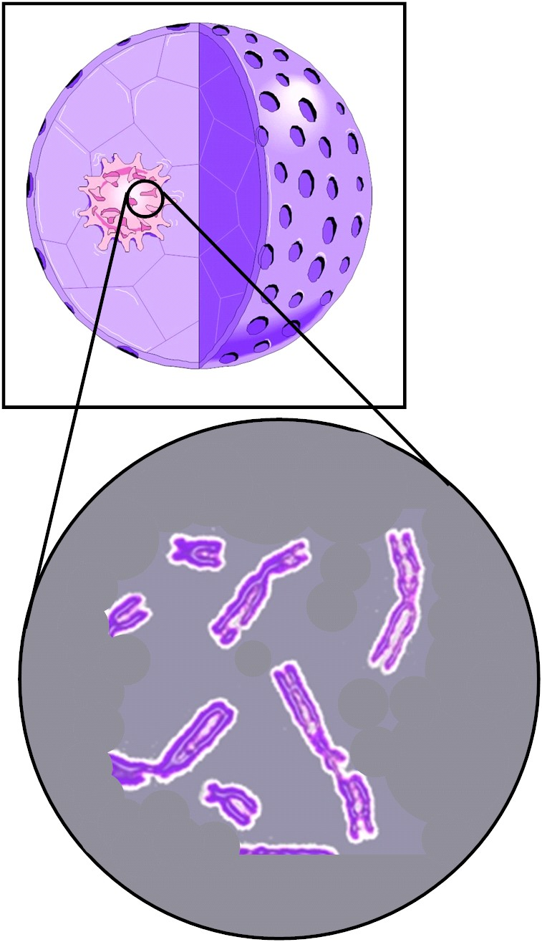
Sperm and egg
What do each of these have?
A nucleus which contains the chromosomes (DNA)
The nucleus contains the chromosomes which carry your DNA.

Slide 7
What is fertilization?
½ Chromosomes
EGG CELL
½ Chromosomes
SPERM CELL
Full set Chromosomes
ZYGOTE

Slide 8
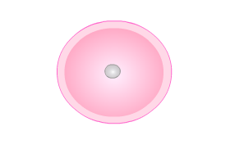
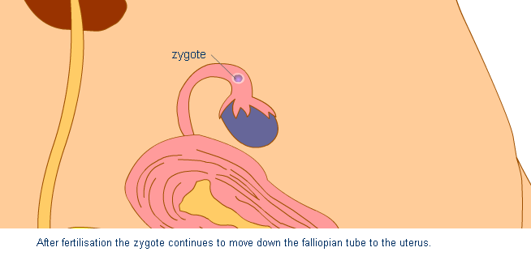
What happens to the zygote?
After fertilization the zygote continues to move down the fallopian tube/oviduct to the uterus

Slide 9
What is fertilization?
The fertilised egg (Zygote) Then divides and copies itself several times. It then becomes a ball of cells called an embryo.

Slide 10
Worksheet: Passing on instructions
Use the keywords to identify the key stages on the worksheet.

Slide 11
Worksheet: Passing on instructions
Use the keywords to identify the key stages on the worksheet.
23
23
23
46
23
46
46
46
46
46
46

Slide 12
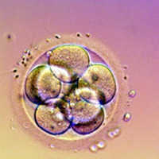
What happens after fertilization?
The zygote (fertilized egg) divides and copies itself.
This is called an embryo. The embryo floats towards the uterus/womb.

Slide 13
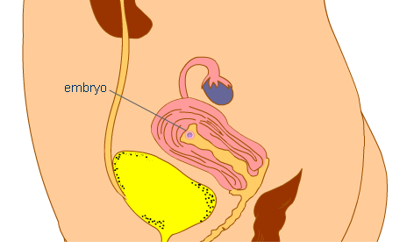
After Fertilization:
Lining of womb/uterus thickens ready to receive the embryo

Slide 14
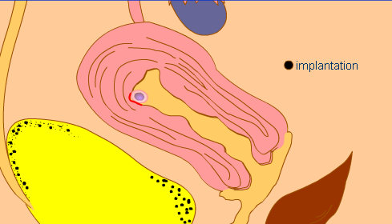
After Fertilization: Implantation
Embryo attaches itself to the uterus wall. This is called IMPLANTATION.

Slide 15
Worksheet: Number the Stages in the Table
Number | What happens?
 | The ZYGOTE reproduces to make a ball of cells called an EMBRYO.
 | The EMBRYO develops into a fetus (an unborn baby).
 | The egg is release from the ovary into the fallopian tube
 | The sperm and egg join together. This is called fertilisation and it makes a ZYGOTE.
 | The EMBRYO travels into the uterus and implants in the lining.

Slide 16
PART 2: PREGNANCY

Slide 17
Pregnancy: Optional Videos
Video 1: https://www.youtube.com/watch?v=92N7WPuoLZM
Video 2: http://www.dnatube.com/video/1127/Human-Reproduction-Fertilization-and-Fetal-Development
Optional info about childbirth: http://www.pbs.org/wgbh/nova/body/anatomy-childbirth.html

Slide 18
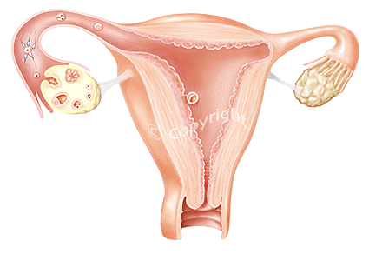
Embryo implants in the uterus wall

Slide 19
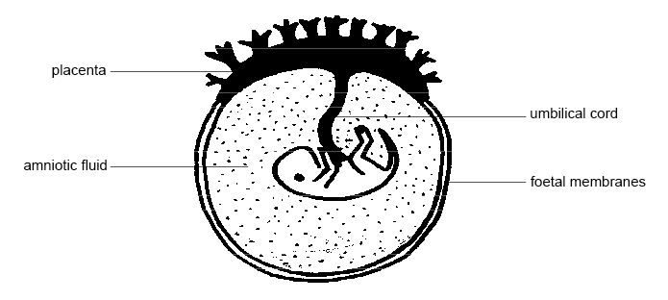
A placenta starts to develop

Slide 20
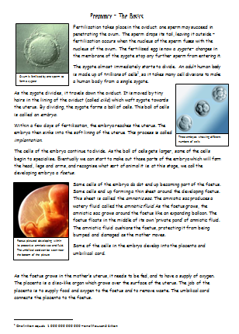
Read the Pregnancy – The Basics reading (class set)
⌛ 5 minutes

Slide 21
✍
Complete the Placenta and Pregnancy worksheet
Fetus
Placenta
Amniotic fluid
Umbilical cord
Lining of uterus
Uterus wall
(made of muscle)

Slide 22
Foetus
Umbilical vein
Blood in
Blood out
Umbilical artery
Placenta

Slide 23
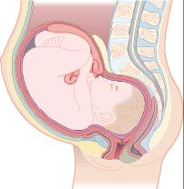
7B Pregnancy - Dangers to fetus
Why does a pregnant woman have to be careful
about what she takes into her body?
A baby is entirely dependent on its mother during pregnancy.
Oxygen and food pass across the placenta from the mother’s blood to the embryo’s blood.
Some harmful substances can also pass across the placenta with serious effects on the developing baby.

Slide 24
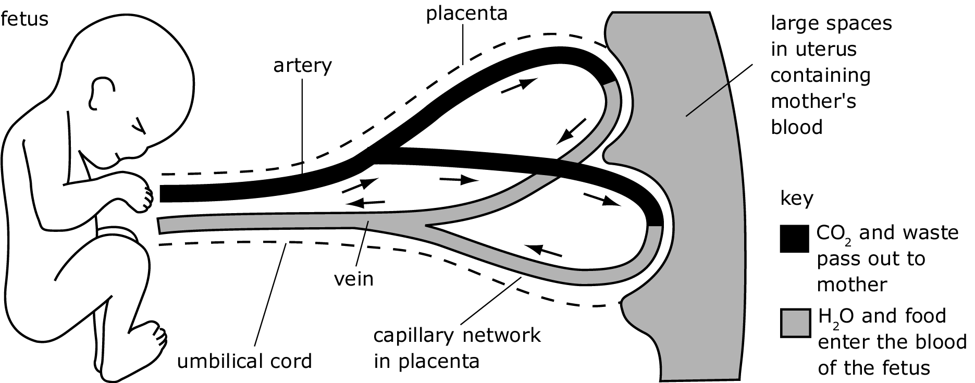
The Placenta
After about 10 weeks the limbs are visible and the embryo becomes a foetus.
The placenta develops. This is an organ containing blood vessels that run very near to those of the mother.
The placenta is connected to the foetus by the umbilical cord.
Oxygen and food pass from the mother’s blood to the blood of the foetus.
Carbon dioxide and waste pass from the foetus to the mother.
Some harmful substances can cross the placenta.

Slide 25
THE PLACENTA
The Placenta

Slide 26
Pregnancy - Dangers to fetus Match the substance to the effect it may have on a developing baby.
Resources for more info: http://www.fasdcenter.samhsa.gov/documents/wynk_effects_fetus.pdf
Harmful substance
Effect on baby
Harmful substance
4 HIV virus
A Fetus may be infected with life-threatening disease before it is born.
1 alcohol
2 drugs
B Oxygen supply is reduced by nicotine and carbon monoxide.
3 smoking
5 Rubella virus
C Embryo infected and cannot develop properly. It may be born blind or deaf.
3 smoking
2 drugs
D Blood vessels and heart may be damaged.
Baby maybe small, born early or born dead.
4 HIV virus
1 alcohol
5 Rubella virus
E Baby may be born underweight or brain-damaged.

Slide 27
PLACENTA

Slide 28
Placenta: Optional Videos
Video 1: https://www.youtube.com/watch?v=bped-RVWsLk
Video 2: https://www.youtube.com/watch?v=bped-RVWsLk

Slide 29
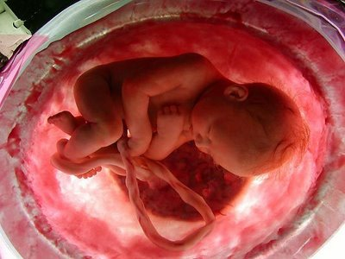
How does the fetus get oxygen?

Slide 30
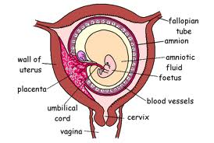
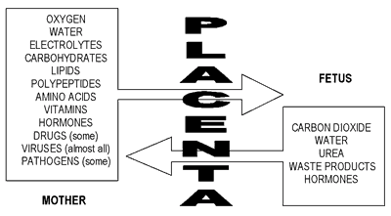
The placenta!
Oxygen
Water
Vitamins
Drugs (some)
Viruses (almost all)
Nutrients
Carbon dioxide
Water
Waste products

Slide 31
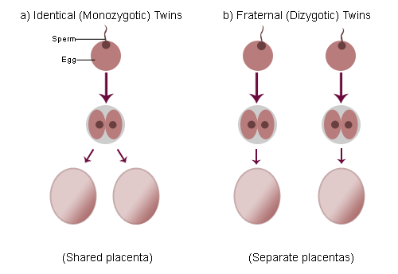
The Placenta: What about twins?
Identical Non-Identical

Slide 32
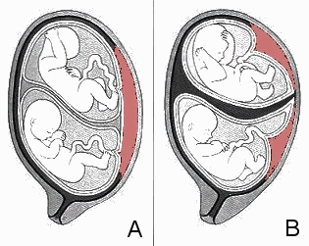
The Placenta: What about twins?
Identical Non-Identical

Slide 33
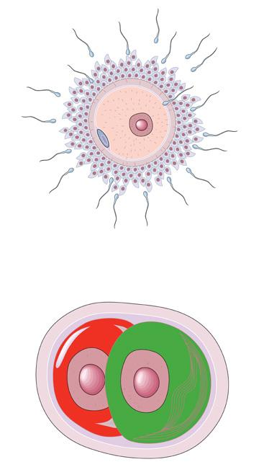
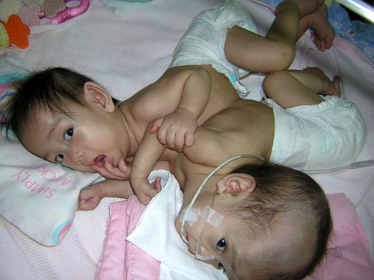
What about twins?
Conjoined Twins
The copied cells do not separate properly! They start to develop individually even though they are joined.

Slide 34
Additional Optional Links
Overview of terms: http://highered.mheducation.com/sites/0072820144/student_view0/chapter4/index.html
http://www.biology.iupui.edu/biocourses/N100/2k4ch39repronotes.html
http://www.biology-online.org/7/1_fertilisation.htm
http://health.howstuffworks.com/pregnancy-and-parenting/pregnancy/conception/human-reproduction6.htm
https://www.ck12.org/life-science/Female-Reproductive-System-in-Life-Science/
http://www.microbiologyonline.org.uk/students/sti-tutorial-quiz
http://www2.estrellamountain.edu/faculty/farabee/BIOBK/BioBookREPROD.html

