Slide 1
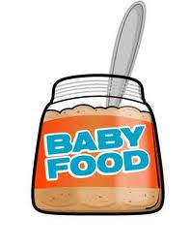
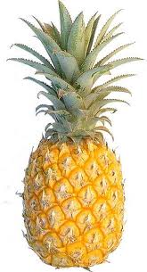
Protease
Proteases break down proteins.
Baby food:
As babies can’t digest solid food, using protease enzymes makes it easier for a baby’s digestive system to cope with it.
Proteases are used to produce baby food from cow’s milk. The proteases break down milk proteins into amino acids, diminishing the risk of babies developing milk allergies.
Particular proteases are also used for the production of hypoallergenic food . These proteases break down specific allergenic proteins that can cause allergic reactions.
What else?
Animals produce digestive enzymes that break down proteins, such as trypsin and pepsin.
Some plants, such as pineapple, have a high protease content. The main enzyme of pineapple is called papain.
Many foodstuffs (meat, cheese, fish) also contain proteases or activate them during the process of maturing. The "hanging" of meat activates digestive enzymes that tenderise the meat.

Slide 2
Protease
Proteases break down proteins.
Baby food:
As babies can’t digest solid food, using protease enzymes makes it easier for a baby’s digestive system to cope with it.
Proteases are used to produce baby food from cow’s milk. The proteases break down milk proteins into amino acids, diminishing the risk of babies developing milk allergies.
Particular proteases are also used for the production of hypoallergenic food . These proteases break down specific allergenic proteins that can cause allergic reactions.
What else?
Animals produce digestive enzymes that break down proteins, such as trypsin and pepsin.
Some plants, such as pineapple, have a high protease content. The main enzyme of pineapple is called papain.
Many foodstuffs (meat, cheese, fish) also contain proteases or activate them during the process of maturing. The "hanging" of meat activates digestive enzymes that tenderise the meat.

Slide 3
Protease
Proteases break down proteins.
Baby food:
As babies can’t digest solid food, using protease enzymes makes it easier for a baby’s digestive system to cope with it.
Proteases are used to produce baby food from cow’s milk. The proteases break down milk proteins into amino acids, diminishing the risk of babies developing milk allergies.
Particular proteases are also used for the production of hypoallergenic food . These proteases break down specific allergenic proteins that can cause allergic reactions.
What else?
Animals produce digestive enzymes that break down proteins, such as trypsin and pepsin.
Some plants, such as pineapple, have a high protease content. The main enzyme of pineapple is called papain.
Many foodstuffs (meat, cheese, fish) also contain proteases or activate them during the process of maturing. The "hanging" of meat activates digestive enzymes that tenderise the meat.

Slide 4
Protease
Proteases break down proteins.
Baby food:
As babies can’t digest solid food, using protease enzymes makes it easier for a baby’s digestive system to cope with it.
Proteases are used to produce baby food from cow’s milk. The proteases break down milk proteins into amino acids, diminishing the risk of babies developing milk allergies.
Particular proteases are also used for the production of hypoallergenic food . These proteases break down specific allergenic proteins that can cause allergic reactions.
What else?
Animals produce digestive enzymes that break down proteins, such as trypsin and pepsin.
Some plants, such as pineapple, have a high protease content. The main enzyme of pineapple is called papain.
Many foodstuffs (meat, cheese, fish) also contain proteases or activate them during the process of maturing. The "hanging" of meat activates digestive enzymes that tenderise the meat.

Slide 5
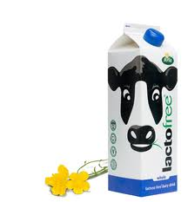
Carbohydrase: Lactase
Carbohydrases are a group of enzymes which digest carbohydrates into the simpler sugars they are made from.
Lactase is a carbohydrase enzyme which helps to break down lactose (a sugar found in milk) into simple sugars.
Lactase is secreted in the intestine to break down the lactose in milk into sugars which can be absorbed. If the enzyme isn’t present, the lactose cannot be converted into sugars such as glucose.
A lack of this enzyme causes lactose intolerance. The lactose can’t be broken down and acts as a great food source for gut bacteria.
The amount of lactase mammals produce tends to decrease with maturity however humans have evolved
to keep producing the enzyme into adulthood due to the amount of milk consumed.

Slide 6
Carbohydrase: Lactase
Carbohydrases are a group of enzymes which digest carbohydrates into the simpler sugars they are made from.
Lactase is a carbohydrase enzyme which helps to break down lactose (a sugar found in milk) into simple sugars.
Lactase is secreted in the intestine to break down the lactose in milk into sugars which can be absorbed. If the enzyme isn’t present, the lactose cannot be converted into sugars such as glucose.
A lack of this enzyme causes lactose intolerance. The lactose can’t be broken down and acts as a great food source for gut bacteria.
The amount of lactase mammals produce tends to decrease with maturity however humans have evolved
to keep producing the enzyme into adulthood due to the amount of milk consumed.

Slide 7
Carbohydrase: Lactase
Carbohydrases are a group of enzymes which digest carbohydrates into the simpler sugars they are made from.
Lactase is a carbohydrase enzyme which helps to break down lactose (a sugar found in milk) into simple sugars.
Lactase is secreted in the intestine to break down the lactose in milk into sugars which can be absorbed. If the enzyme isn’t present, the lactose cannot be converted into sugars such as glucose.
A lack of this enzyme causes lactose intolerance. The lactose can’t be broken down and acts as a great food source for gut bacteria.
The amount of lactase mammals produce tends to decrease with maturity however humans have evolved
to keep producing the enzyme into adulthood due to the amount of milk consumed.

Slide 8
Carbohydrase
Carbohydrases are a group of enzymes which digest carbohydrates into the simpler sugars they are made from.
Used to convert starch syrup, which is relatively cheap, into sugar (glucose) syrup, which is more valuable - for example, as an ingredient in sports drinks.
We can get starch from plants eg: corn which is very cheap. Using carbohydrases to convert this to sugar means it is a cheap source of sweetness for food manufacturers
Carbohydrases are also used in making fuel from plants (ethanol).

Slide 9
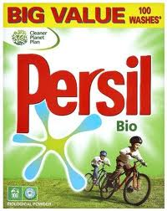
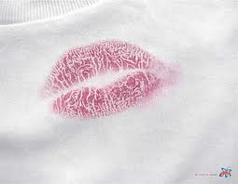
Biological detergents
Used to remove stains such as blood, grass, sweat and food from clothes.
Biological washing powders contain proteases and lipases. Proteases break down proteins and lipases break down fats in the stains into smaller water soluble substances.
They still work at the lower temperatures enzymes work at, which makes washing more environmentally friendly.

Slide 10
Biological detergents
Used to remove stains such as blood, grass, sweat and food from clothes.
Biological washing powders contain proteases and lipases. Proteases break down proteins and lipases break down fats in the stains into smaller water soluble substances.
They still work at the lower temperatures enzymes work at, which makes washing more environmentally friendly.

Slide 11
Biological detergents
Used to remove stains such as blood, grass, sweat and food from clothes.
Biological washing powders contain proteases and lipases. Proteases break down proteins and lipases break down fats in the stains into smaller water soluble substances.
They still work at the lower temperatures enzymes work at, which makes washing more environmentally friendly.

Slide 12
Biological detergents
Used to remove stains such as blood, grass, sweat and food from clothes.
Biological washing powders contain proteases and lipases. Proteases break down proteins and lipases break down fats in the stains into smaller water soluble substances.
They still work at the lower temperatures enzymes work at, which makes washing more environmentally friendly.

Slide 13
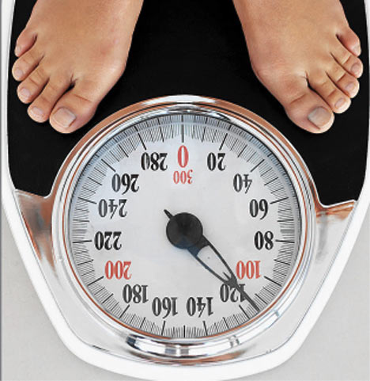
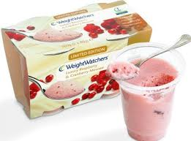
Isomerase
Isomerase enzyme is used to convert glucose syrup into fructose syrup. it does this by rearranging the atoms in the glucose molecules.
The enzyme isomerase is normally "immobilised" when used, i.e., it is fixed to a transporter and is not transferred to the product or ingredient on which it is used.
Glucose and fructose contain the same amount of energy however fructose is a sugar which is sweeter than glucose.
Using fructose in foods means that less is needed which is why it is used in slimming foods. Food tastes sweet but contains fewer calories!

Slide 14
Isomerase
Isomerase enzyme is used to convert glucose syrup into fructose syrup. it does this by rearranging the atoms in the glucose molecules.
The enzyme isomerase is normally "immobilised" when used, i.e., it is fixed to a transporter and is not transferred to the product or ingredient on which it is used.
Glucose and fructose contain the same amount of energy however fructose is a sugar which is sweeter than glucose.
Using fructose in foods means that less is needed which is why it is used in slimming foods. Food tastes sweet but contains fewer calories!

Slide 15
Isomerase
Isomerase enzyme is used to convert glucose syrup into fructose syrup. it does this by rearranging the atoms in the glucose molecules.
The enzyme isomerase is normally "immobilised" when used, i.e., it is fixed to a transporter and is not transferred to the product or ingredient on which it is used.
Glucose and fructose contain the same amount of energy however fructose is a sugar which is sweeter than glucose.
Using fructose in foods means that less is needed which is why it is used in slimming foods. Food tastes sweet but contains fewer calories!

Slide 16
Isomerase
Isomerase enzyme is used to convert glucose syrup into fructose syrup. it does this by rearranging the atoms in the glucose molecules.
The enzyme isomerase is normally "immobilised" when used, i.e., it is fixed to a transporter and is not transferred to the product or ingredient on which it is used.
Glucose and fructose contain the same amount of energy however fructose is a sugar which is sweeter than glucose.
Using fructose in foods means that less is needed which is why it is used in slimming foods. Food tastes sweet but contains fewer calories!

